Slide 1
Creating and Adding Custom IP
Zynq
Vivado 2015.2 Version

Slide 2
Outline
AXI4 Transactions
AXI4-Lite Slave
AXI4-Lite Master
Create and Package IP
Custom IP
Summary

Slide 3
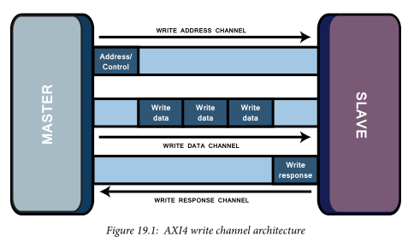
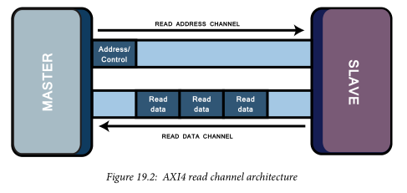
Introducing AXI Interconnect Protocol
AXI is a protocol belonging to the ARM AMBA family of microcontroller buses.
The AMBA protocol is an open standard on-chip interconnect specification, allowing the connection and management of many controllers and peripherals in a multi-master design.
The AXI protocol is optimized for FPGA implementation through coordinated development with Xilinx and is used as a means of communication between IP cores of an FPGA design.

Slide 4
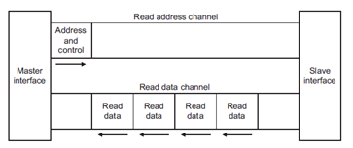
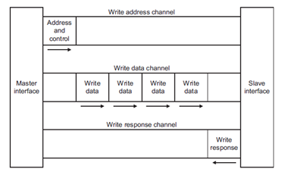
Basic AXI Transaction Channels
Read address channel
Read data channel
Write address channel
Write data channel
Write response channel
Notes:
Non-posted write model
There will always be a "write response

Slide 5
All AXI Channels Use A Basic “VALID/READY” Handshake
SOURCE asserts and holds VALID when DATA is available
DESTINATION asserts READY if able to accept DATA
DATA transferred when VALID and READY = 1
SOURCE sends next DATA (if an actual data channel) or deasserts VALID
DESTINATION deasserts READY if no longer able to accept DATA

Slide 6
AXI4-Lite Slave
AXI4-Lite is a subset of AXI (Full)
Same channels, but less signals than full interface
5 AXI channels
Inputs: Write Address, Data; Read Address
Outputs: Write Response; Read Data
Slave responds to read and write transactions from upstream Master
1 data transfer per transaction
No burst support
Intended for lower performance peripherals
led_ip_v1_0.v
AXI Interconnect
led_ip_v1_0_S_AXI.v
Write Addr
AXI Transaction logic
(Ready, Valid, Response)
User IP
AXI4-Lite IP (Slave)
Write Data
Write Response
Read Addr
Registers
Read Data
lab3_user_logic.v

Slide 7
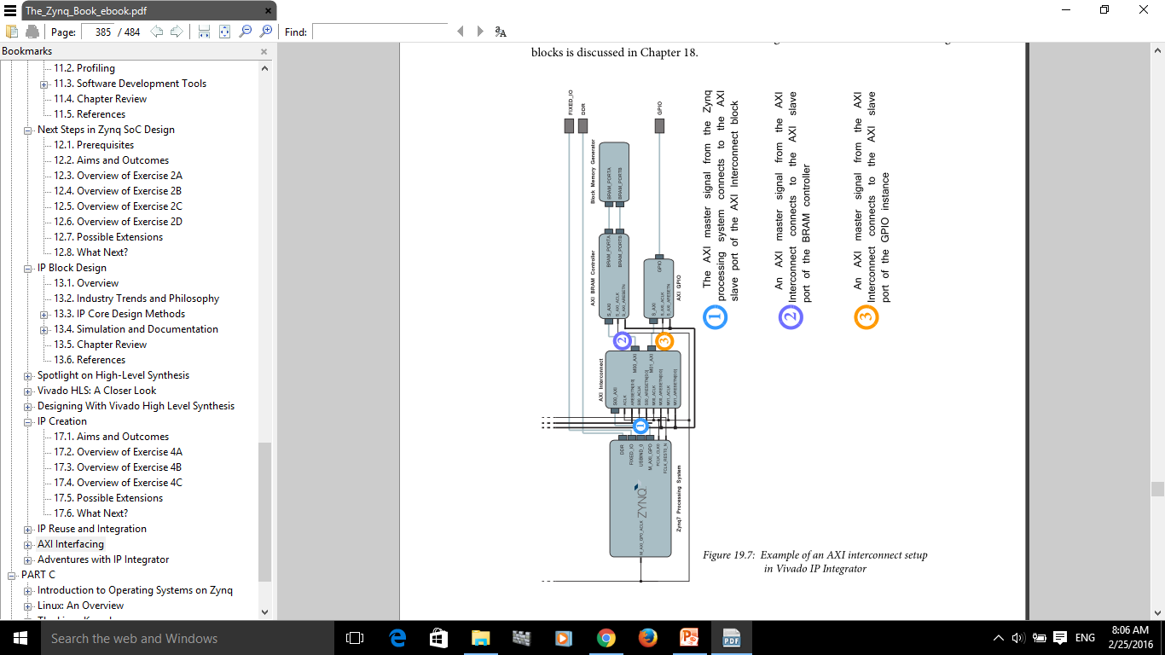
Example – AXI is Connected to Two Slaves: AXI GPIO and AXI BRAM
The AXI interconnect is a slave to the master processing system, and is a master routing signals from the processor to various instances of slave AXI devices. In this system, the interconnect is connected to two slave devices; AXI GPIO (gpio_1) and an AXI BRAM controller (bram_ctrl_1).

Slide 8
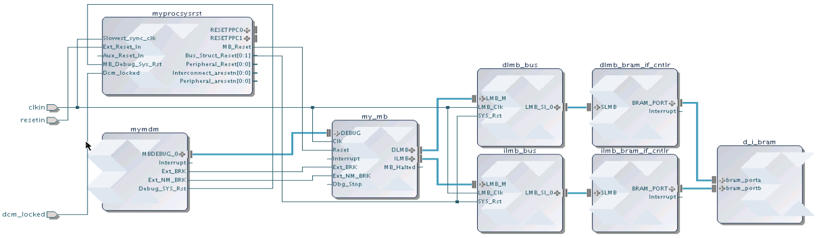
Reusing Your IP
IP from many sources can be packaged and made available in Vivado
All IP available in the Vivado IP Catalog can be used to create IP Integrator designs
Any IP Integrator diagram can be quickly packaged as a single complex IP
Standardized IP-XACT representation
Vivado IP Integrator
IP Catalog
Source (C, RTL, IP, etc)
Simulation Models
IP Packager
Xilinx IP
Documentation
Example Designs
3rd Party IP
Test Bench
User IP
Notes:
Vivado supports reuse of IP is by providing users a means to capture their individual IP or IP subsystems and package that IP, and then make the IP available to other users through the Vivado IP catalog. This approach also benefits third party IP providers, who now have a standard way of providing their IP for both evaluation and purchase, and that IP will be visible through the IP Catalog.
Packaging an IP Integrator diagram takes one Tcl command, or several mouse clicks.

Slide 9
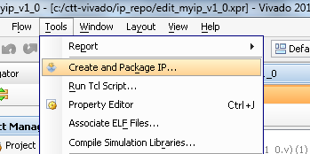
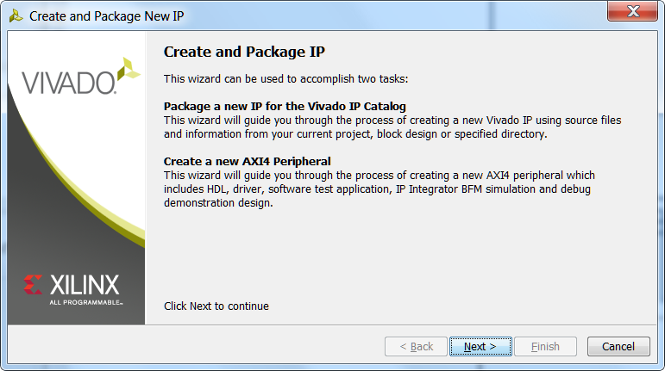
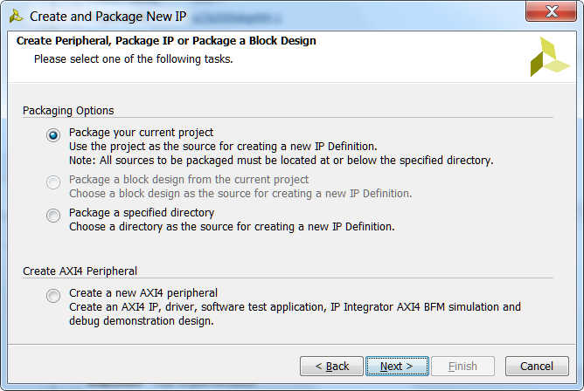
Create and Package IP
The Create and Package IP wizard allows you to
Create a template for a new peripheral
Package the current project
Only available if project is open
Package an existing project
The packager allows IP to be included in the IP Catalog for distribution
It uses IP-XACT format
Complete set of files included
Source code, Constraints, Test Benches (simulation files), documentation

Slide 10
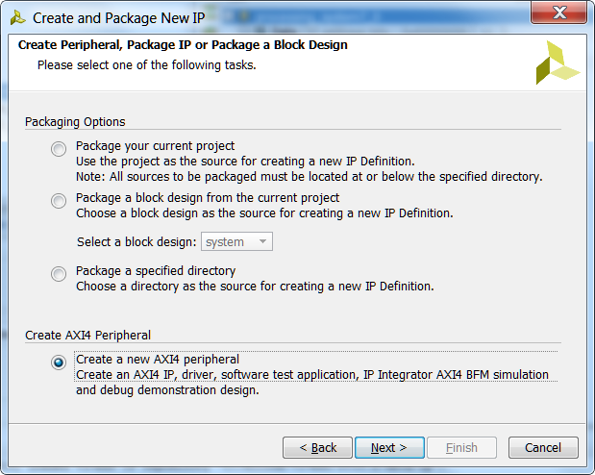
Create Custom IP
Create and Package IP Wizard
Generates HDL template for
Slave/Master
AXI Lite/Full/Stream
Optionally Generates
Software Driver
Only for AXI Lite and Full slave interface
Test Software Application
AXI4 BFM (Bus Function Model) Example to verify functionality of masters and slaves .

Slide 11
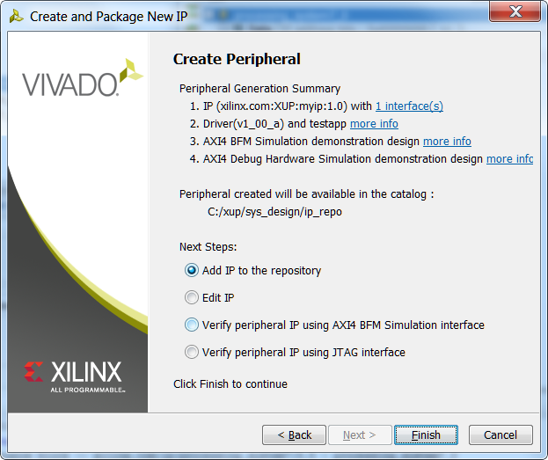
Create Custom IP
Add IP to repository
Edit IP
Verify
BFM Simulation Example Design
JTAG

Slide 12
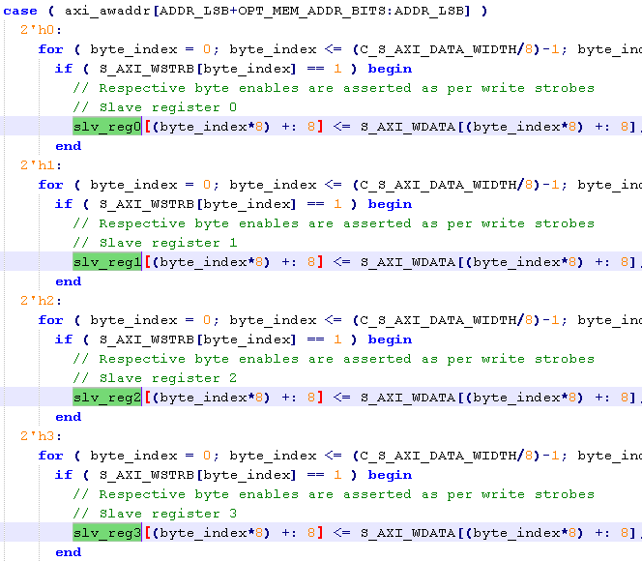
Generated Template for AXI Lite
HDL implementation of AXI Interface
32 bit data width
User specifies required number of registers (minimum 4)
Read from/write to Registers implemented
User logic can be easily connected
User logic can be a hierarchical design

Slide 13
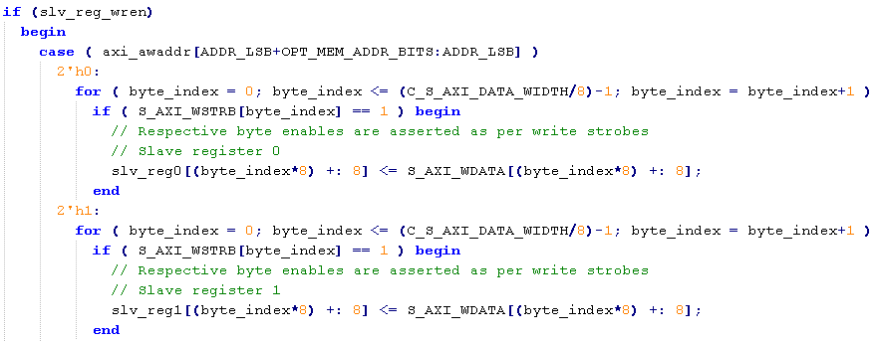
HDL AXI Lite
Connect user logic to registers, or modify design
Address
Register
Data

Slide 14
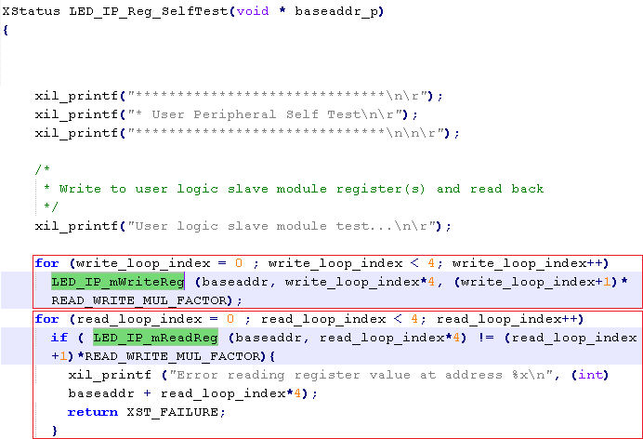
Files created
component.xml
IP XACT description
bd
Block Diagram tcl file
drivers
SDK and software files (c code)
Simple register/memory read/write functionality
Simple SelfTest() code
hdl
Verilog/VHDL (should be inside project directory
xgui
GUI tcl file

Slide 15
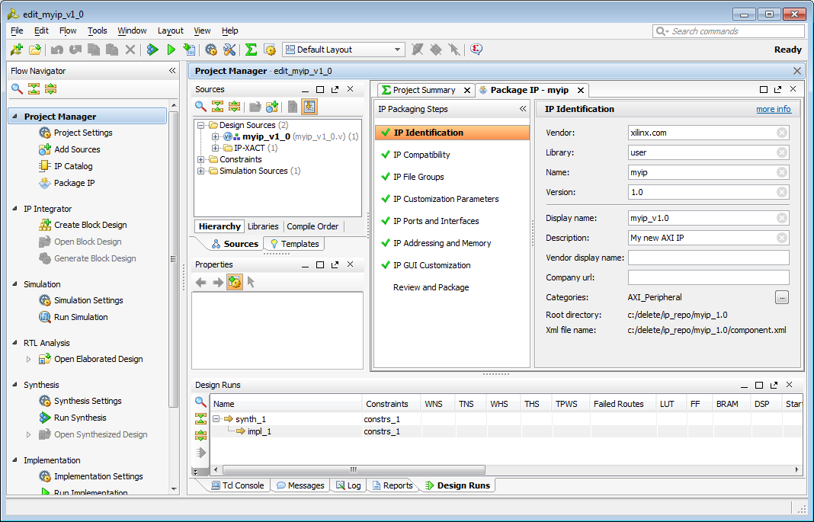
Edit IP
New Vivado project will open
Template files have been generated and are added to the project
IP can now be edited
Modify existing template files, add user source files
IP Packager will be open
Last step is to Package IP

Slide 16
Package IP
Package current project
Must be open!
Package generated HDL
Package a directory (another project/source files)
Option to package as a library core
Core can be referenced by other IP
Core not available standalone (Will not display in IP Catalog)
Create New AXI4 Peripheral (previous section)
Will also need to be packaged
Similar steps to package for all three flows

Slide 17

IP Packager
Automatically analyse project/files to determine parameters
Initial Summary
Identifies
Files
Source HDL, Testbenches, Documentation,
Parameters
Configurable
Ports
Interfaces
Compatibility
Creates GUI Layout for IPI

Slide 18
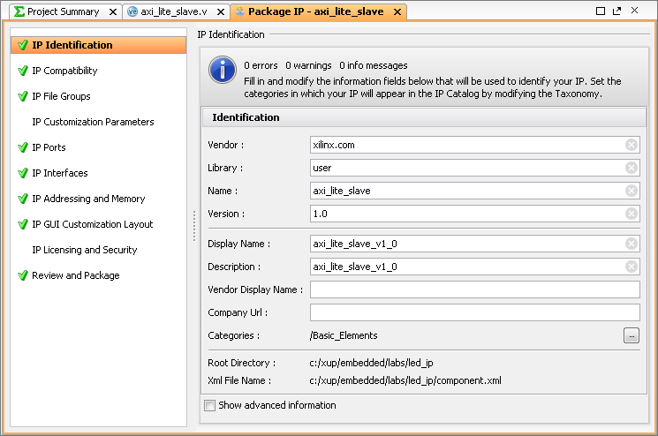
IP Packager
Modify configuration
Properties
Compatibility
Files
Custom parameters
Ports
Interfaces
Address and Memory
IP and security
Project can be updated – e.g. source files added
Changes will be reflected in packager
Review and package

Slide 19
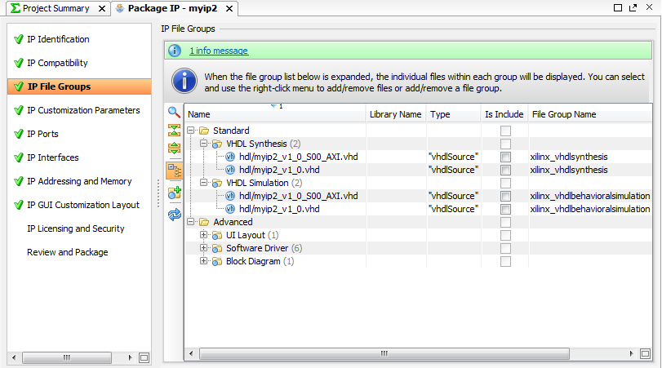
Customizing IP for Reuse in IP Packager
Select
Options
Add, Edit or change defaults
Notes:
The packager handles all the IP-XACT specific file creation, manages IP versions, recognizes interfaces, and creates customized configuration dialogs, as well as more advanced functionality.

Slide 20
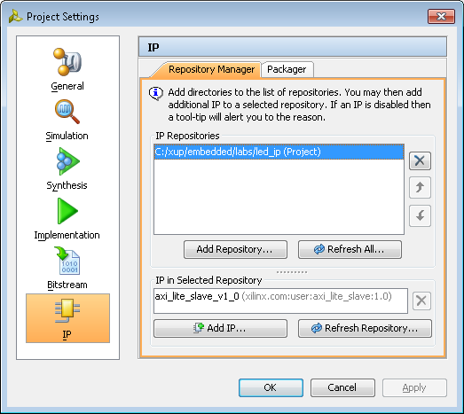
IP repository
The Vivado IP Catalog can be extended by adding additional IP Repositories.
Third party IP, your custom IP, and Xilinx IP are displayed in an identical manner
Packager creates .xml file for the IP
Specify the directory of the user/third party IP repository
Can be done automatically from packager
Access from project settings, or IP Catalog
Displays the IP that has been found
Displays IP in the repository for use in IPI

Slide 21
Summary
AXI4 interface defines five channels
All channels use basic VALID/READY handshake to complete a transfer
AXI Interconnect extends AXI interface by allowing 1-to-N, N-to-1, N-to-M, and M-to-N connections
Custom IP can be imported using IP Packager
Include in the IP Repository for reuse across projects
Create and Package wizard supports AXI Lite, Full, and Stream compatible IP creation and packaging
Handles interface side protocol
Provides template to add HDL functionality
Packages into the IP Catalog

Slide 22
Zybo Reference Manual
https://reference.digilentinc.com/reference/programmable-logic/zybo/reference-manual

